Slide 1
Projet IA
Adversarial Training

Slide 2
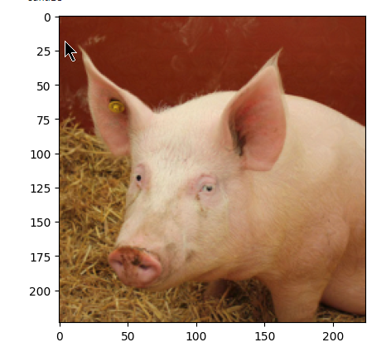
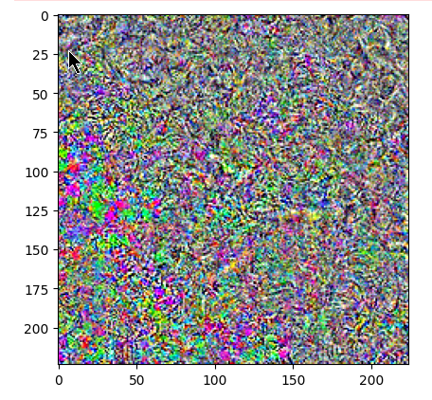
Introduction to Adversarial Training Improving Model Robustness with Adversarial Training
Background:
Adversarial attacks exploit model vulnerabilities to misclassify inputs by introducing small perturbations.
Common attacks used: FGSM, PGD (L0, L2, L∞).
Objective:
Compare baseline model accuracy against adversarial trained models.
Evaluate robustness vs. accuracy tradeoff.
Methodology:
Implemented adversarial training using FGSM and PGD with different norms.
Fine-tuned baseline model with adversarial examples.

Slide 3
Model Performance Analysis Impact of Adversarial Training on Accuracy
Baseline Model Results:
High accuracy on clean images (95.3%).
Significant drop under attacks:
FGSM: 0.4%, PGD-L0: 0.04%, PGD-L∞: 11.2%.
Adversarial Trained Models:
model_withattackFGSM: Improved FGSM robustness (77.1%) but limited performance on stronger attacks.
model_withattackPGD: Best robustness across attacks, e.g., PGD-L0: 97.6%.
model_withattackPGDL2 & PGDLinf: Balanced performance; strong against PGD-L2/L∞.
Attack | None | FGSM | PGD L0 | PGD L2 | PGD Linf
Model
model_noattack | 0.95 | 0.00 | 0.00 | 0.01 | 0.11
model_withattackFGSM | 0.19 | 0.77 | 0.44 | 0.24 | 0.27
model_withattackPGD | 0.56 | 0.90 | 0.98 | 0.68 | 0.79
model_withattackPGDL2 | 0.97 | 0.32 | 0.79 | 0.96 | 0.94
model_withattackPGDLinf | 0.93 | 0.63 | 0.92 | 0.93 | 0.94
Clean accuracy
Robust accuracy

Slide 4
Fine-Tuning Results and Key Takeaways Fine-Tuning Baseline for Robustness
Fine-Tuned Model Performance:
Significant improvements across all attacks:
PGD-L0: 96.6%, PGD-L∞: 98.1%.
Demonstrates adaptability of adversarial training for baseline models.
Key Takeaways:
Adversarial training strengthens model robustness but may trade-off clean accuracy.
PGD is more effective for training robust models compared to FGSM.
Fine-tuning provides an efficient alternative to re-training from scratch.
Future Work:
Combine adversarial training techniques.
Explore tradeoff optimization between clean and robust accuracy.
Model | Attack | Accuracy
model_finetuned | None | 0.74
model_finetuned | FGSM | 0.69
model_finetuned | PGD L0 | 0.97
model_finetuned | PGD L2 | 0.90
model_finetuned | PGD Linf | 0.98

